Slide 1
First Quarter Arch Bridge Design Competition
By: Kevin S, Wesley, Danny

Slide 2
Design:
Our design consists of a foam arc that has been cut up into 12 equal pieces that, when assembled, forms an arc.
The keystone is really any piece, since each block is essential to the arc, but the 2 center blocks would be the most likely candidates.
Foam is the opportune material, since it is abrasive, light weight, and easy to cut.
We predict that the span will be 8 inches long, and that our longest side will be 1 and 5/16th of an inch. Therefore, our overall score will be…
6.095238

Slide 3
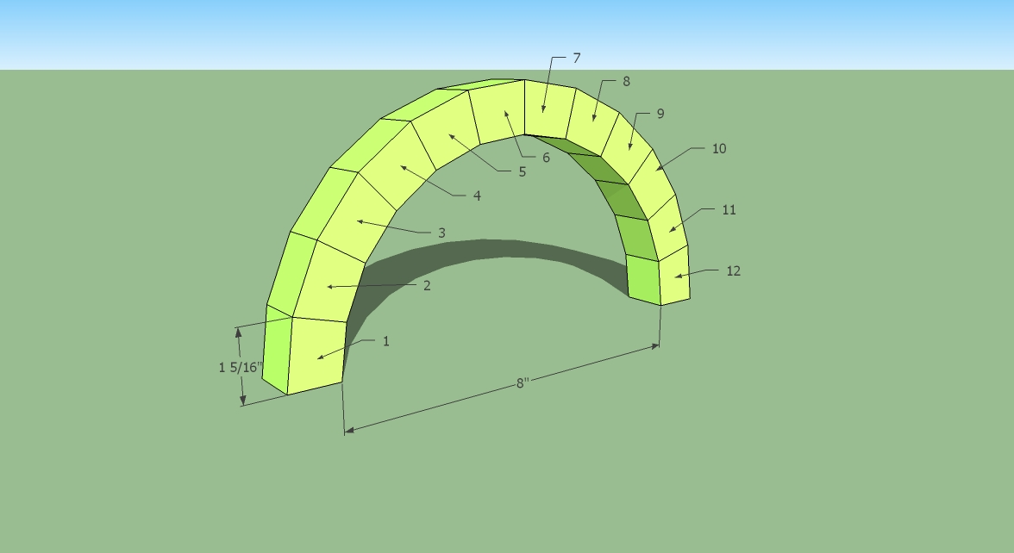
Picture of our Idea:

Slide 4
And Now…
The Real Thing…

Slide 5
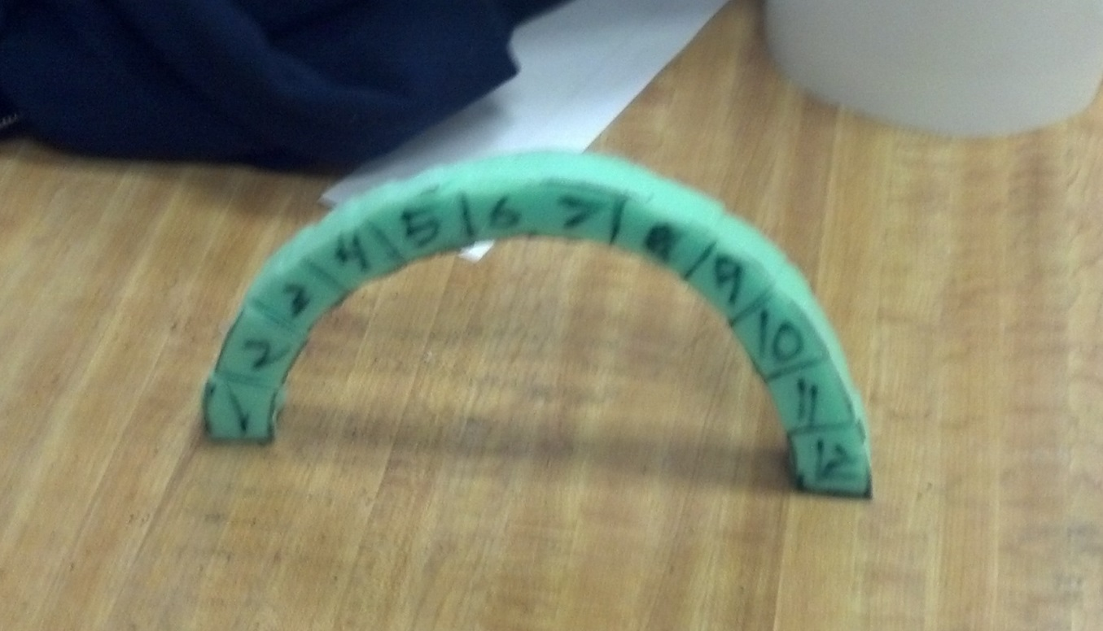
Final Design:
We Got 2nd
This is our final design. It ended up just barely standing up on its own and the span was 7 and 15/16” and the longest block was 1 and ¼”. So both dimensions were only 1/16” smaller, giving us our final score of:
6.35

Slide 6
Lessons Learned:
If our team was to repeat this challenge, we would basically make the same bridge again because it worked the best.
If we could change our bridge so that it could be better the next time around, we would cut the blocks into smaller pieces so that we would end up having a better overall score.

Slide 7


